Slide 1
Dictionaries
TIP101
Notes:
🌟 Purpose: Introduce the session and set the tone for learning about dictionaries.
✅ What should I be doing?
Welcome students to the session with enthusiasm.
Recap key concepts from the previous week to create continuity.
🎙️ What should I be saying?
Welcome back to Week 2 of TIP101! Today, we’re diving into dictionaries—one of Python’s most powerful tools for managing and retrieving data efficiently.
Last week, we worked on mastering lists. This week, we’ll take it further with dictionaries to solve more complex problems.
🙌🏽 How should I engage students?
Ask: "What’s one thing you remember or found challenging about lists last week?" Use responses to bridge into the day’s topic.

Slide 2
1 | Welcome 👋🏽 | 10 minutes
2 | Time Management | 10 minutes
3 | Dictionaries | 25 minutes
4 | BREAK | 5 minutes
5 | AI Checkpoint #1 | 10 minutes
6 | Collaborative Problem Solving | 50 minutes
7 | Wrap Up | 10 minutes
Notes:
🌟 Purpose: Provide an overview of the session and set expectations.
✅ What should I be doing?
Walk through the session’s schedule and ensure students understand the flow.
🎙️ What should I be saying?
Here’s what we’ll cover today: We’ll start with time management tips, then move into an introduction to dictionaries. After a quick break, we’ll spend the second half of the session solving problems collaboratively.
🙌🏽 How should I engage students?
Pause to ask if anyone has questions about the schedule or if they need clarification about the session’s goals.

Slide 3
Welcome! 👋🏽
10 minutes

Slide 4


Turn on your cameras
Fill out the entry ticket
Notes:
🌟 Purpose: Encourage visual engagement to foster connection during the session.
✅ What should I be doing?
Prompt students to enable their cameras and submit the entry ticket.
🎙️ What should I be saying?
Let’s kick off our session by turning on our cameras!
Also, don’t forget to fill out the entry ticket to help us organize breakout rooms later.
🙌🏽 How should I engage students?
Use humor or compliments: "Let’s see those smiles!"
Acknowledge and thank students who turn on their cameras.

Slide 5
5 minutes
👨🏾‍🍳Question:
Cooking is one of the best skills to have. Where do you rank yourself on the chef scale? What is your go to dish to make for an event?
💬Answer:
Share your answer in the Zoom chat below. See who your cooking competition might be!

Slide 6
Students are excited to meet their classmates.
High class confidence level.
- VS Code logistics (Garage Session reminder!)
- Pacing discussions (unit test based pacing).
Notes:
🌟 Purpose: Share feedback from the previous session and highlight areas of success and improvement.
✅ What should I be doing?
Summarize feedback from the previous session's survey and present key takeaways.
🎙️ What should I be saying?
From your feedback, it seems many of you enjoyed [highlighted aspect]. One suggestion was [area for improvement]. We’ll work on that today.
🙌🏽 How should I engage students?
Ask: "Does anyone have additional feedback or suggestions?"

Slide 7

Announcements & Reminders
Don't Forget Cameras On!
You will be removed from today's session if you are not on camera and are unresponsive.
You will be unable to return to today's session if you are removed.
Notes:
🌟 Purpose: purpose
✅ What should I be doing?
Stuff
🎙️ What should I be saying?
Stuff
🙌🏽 How should I engage students?
stuff

Slide 8
Announcements & Reminders
Class and study hall recordings have begun getting posted below.
They be found on the course portal under the Resources tab.
Instructor Led Sessions Playlist
Study Hall Playlist
Fix-it Garage Playlist
Assessment Reminder:
Students must submit one attempted HackerRank assessment weekly to remain in the course (due Sunday at 11:59pm PST). Please reach out to support channels if unexpected delays occur.
If a student moves ahead early in the units, and finishes passes all 10 units, they no longer require weekly attempts, but attendance is still mandatory.
Notes:
🌟 Purpose: purpose
✅ What should I be doing?
Stuff
🎙️ What should I be saying?
Stuff
🙌🏽 How should I engage students?
stuff

Slide 9

Choosing Your Breakout Room
We’ll share the link to the entry ticket so you can indicate what unit you are on.
We’ll create breakout groups based on the unit you selected.
When it’s Collaborative Problem Solving time, we’ll share the room assignments and demonstrate how to get to your room.
Notes:
🌟 Purpose: Prepare students for collaborative problem-solving time.
✅ What should I be doing?
Explain the breakout room process and answer any logistical questions.
🎙️ What should I be saying?
We’ll use your entry tickets to assign breakout rooms based on your progress in the course. Once assigned, you’ll navigate to your room and start working with your group.

Slide 10
Time Management
10 minutes

Slide 11
3 minutes
Grab a scrap piece of paper or a sticky note!
Write down one short-term goal for this week and one long-term goal for the course.
Notes:
🌟 Purpose: Encourage students to set goals and prioritize their time effectively.
✅ What should I be doing?
Guide students to write down a short-term and long-term goal on paper or a sticky note.
🎙️ What should I be saying?
Grab a sticky note or a piece of paper and write down one goal for this week and one long-term goal for this course. For example, a short-term goal could be 'complete all problems in Unit 2,' and a long-term goal might be 'pass the HackerRank assessments on the first try.
🙌🏽 How should I engage students?
Ask students to hold their goals up to the camera or share them in the chat.

Slide 12

Balancing Study with Other Commitments
Identify non-negotiables (e.g., work, family) and fit study time around them.
Be realistic about what you can accomplish!
Notes:
🌟 Purpose: Help students recognize and manage external commitments while maintaining consistency.
✅ What should I be doing?
Share practical strategies for balancing commitments and studying.
🎙️ What should I be saying?
We all have responsibilities outside this course, whether it’s work, family, or other activities. The key is to create a realistic schedule. Identify your non-negotiables and plan your study time around them.
🙌🏽 How should I engage students?
Share your own challenges and strategies to make it relatable. Then ask: "What’s one way you’ve managed to stay consistent in your learning?"

Slide 13
3 minutes
In the chat . . .
What challenges do you face in balancing study with other commitments?
How do you plan to overcome them? Any suggestions for time management that work well for you? Think about how to integrate UMPIRE into your study approach. (Look up Leetcode Patterns)
Notes:
🌟 Purpose: Create a space for students to share their challenges and solutions for balancing commitments.
✅ What should I be doing?
Facilitate a discussion in the chat or use a Zoom poll.
🎙️ What should I be saying?
"What challenges do you face in balancing study with other commitments? How do you plan to overcome them? Share your thoughts in the chat or unmute to share.
🙌🏽 How should I engage students?
Acknowledge responses and thank students for sharing. If using a poll, discuss the results and common themes.

Slide 14
Dictionaries
25 minutes

Slide 15
3 minutes
What do we know about dictionaries?
Notes:
🌟 Purpose: Assess students' prior knowledge and build a foundation for the lesson.
✅ What should I be doing?
Facilitate an open discussion to gauge familiarity with dictionaries.
🎙️ What should I be saying?
Let’s brainstorm: What do we already know about dictionaries in Python? For example, how are they different from lists or sets?
🙌🏽 How should I engage students?
Prompt students with examples: "A dictionary is like a phonebook with names as keys and numbers as values. Can you think of other examples?"

Slide 16
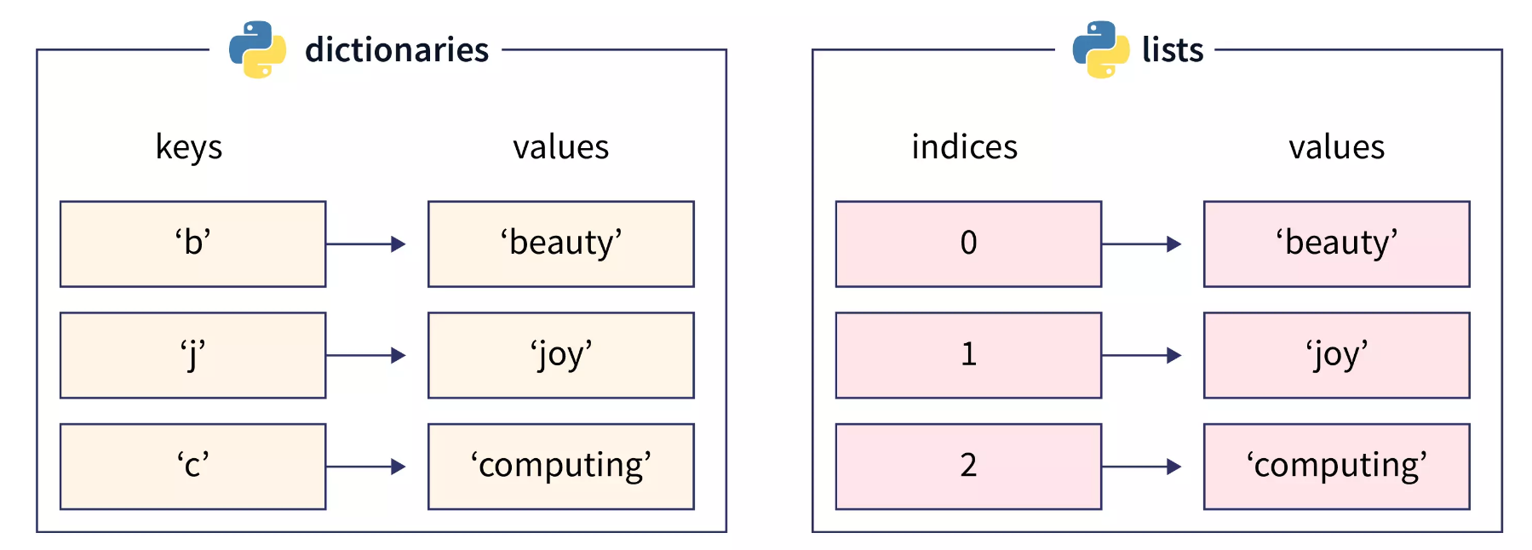
Dictionaries
Key-value pairs for fast lookups.
Use cases: Efficient retrieval and updating of data by unique keys.
Notes:
🌟 Purpose: Introduce dictionaries as a data structure for efficient data retrieval.
✅ What should I be doing?
Explain the concept of key-value pairs and their use cases.
🎙️ What should I be saying?
A dictionary is a collection of key-value pairs where each key is unique. This makes it perfect for tasks like looking up user data or creating frequency maps.
For example, if we’re counting the frequency of words in a sentence, a dictionary can map each word to its count.
🙌🏽 How should I engage students?
Ask: "What are some scenarios where you might use a dictionary in a program?"

Slide 17
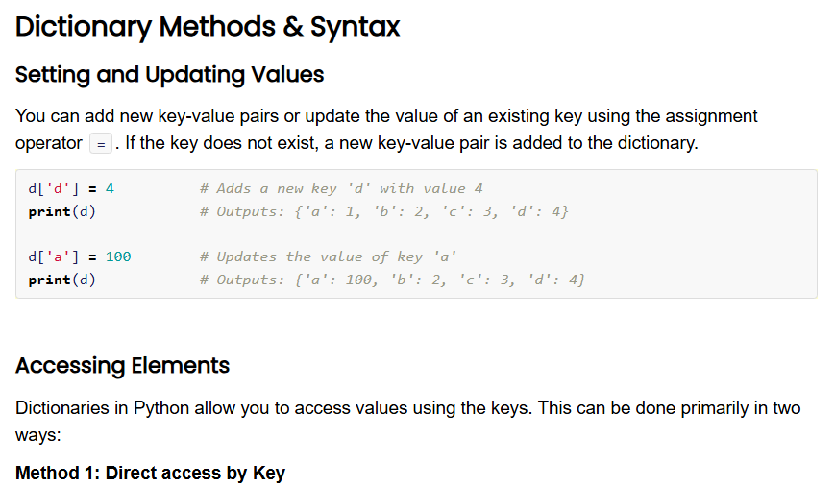
5 minutes
Open the Unit 2 Cheat Sheet and find Dictionary Methods & Syntax. Take a moment to review the functions and examples.
What do you notice?
What do you wonder?
Notes:
🌟 Purpose: Familiarize students with dictionary methods and syntax.
✅ What should I be doing?
Guide students through exploring the cheat sheet and answering questions.
🎙️ What should I be saying?
Take a look at the Dictionary Methods & Syntax section in the Unit 2 Cheat Sheet. What do you notice? What do you wonder?
🙌🏽 How should I engage students?
Invite students to share their observations and clarify any misconceptions.

Slide 18
Common Use Cases
Frequency maps: Counting the frequency of characters in a string or elements in a list. This ecompasses simple “does it exist” checks as well.
Key-value data storage: Storing data for quick 1 to 1 lookups:
Contact name : phone number
English word : Spanish word
Software setting : Is enabled? (yes or no)
Notes:
🌟 Purpose: Highlight practical applications of dictionaries.
✅ What should I be doing?
Provide examples of real-world scenarios where dictionaries are essential.
🎙️ What should I be saying?
Dictionaries are incredibly versatile. You can use them to count character frequencies, store configurations, or even implement simple caching systems.
🙌🏽 How should I engage students?
Ask: "Can you think of a problem you’ve solved or could solve using a dictionary?"

Slide 19
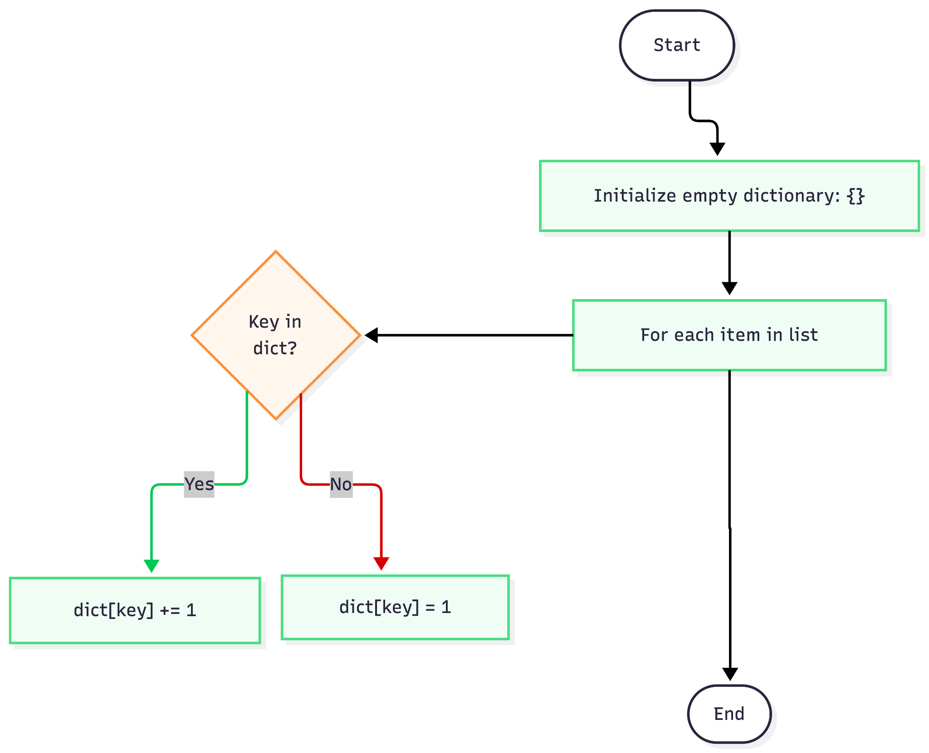
Frequency Map Flowchart
Notes:
🌟 Purpose: Reinforce the differences between lists and dictionaries with practical examples.
✅ What should I be doing?
Provide clear examples to illustrate each use case.
🎙️ What should I be saying?
Lists are perfect for ordered collections of data that you’ll loop through. Dictionaries are ideal when you need to associate data using keys, like a phonebook or a frequency counter.
For instance, if you’re building a program that counts the number of times each word appears in a text, a dictionary would let you map each word to its count efficiently.
🙌🏽 How should I engage students?
Prompt: "Which data structure would you use to store a collection of email addresses and the number of emails each person has sent?"

Slide 20
UPI Recap
UNDERSTAND
IMPLEMENT
REVIEW
MATCH
PLAN
EVALUATE
Notes:
🌟 Purpose: Reinforce the importance of the UMPIRE strategy for problem-solving.
✅ What should I be doing?
Recap the Understand, Plan, and Implement steps.
🎙️ What should I be saying?
Let’s revisit UPI. First, understand the problem requirements. Next, create a clear plan with pseudocode. Finally, implement your solution and test it thoroughly.
🙌🏽 How should I engage students?
Ask: "Which of these steps do you find most challenging, and why?"

Slide 21
Given a list of strings words, group the strings that are anagrams of each other.
An anagram is defined as a word formed by rearranging the letters of another, such as "eat" and "tea".
def group_anagrams(words):
pass
Input: words = ["eat", "tea", "tan", "ate", "nat", "bat"]
Output: [["eat", "tea", "ate"], ["tan", "nat"], ["bat"]]
Notes:
🌟 Purpose: Demonstrate solving the "Group Anagrams" problem using the UMPIRE strategy, showcasing the efficiency of dictionaries in categorizing and grouping data.
✅ What should I be doing?
Guide students through solving the problem step by step using the UMPIRE strategy.
Emphasize understanding the problem, creating a clear plan, implementing the solution, and handling edge cases.
Normalize mistakes by intentionally introducing errors and debugging them.
🎙️ What should I be saying?
1. Understand the Problem
"Let’s start by understanding the problem. We need to group strings that are anagrams of each other. An anagram is a word formed by rearranging the letters of another, like 'eat' and 'tea.'"
"Our input is a list of strings, and our output should be a list of lists, where each list contains words that are anagrams."
"For example, if the input is ['eat', 'tea', 'tan', 'ate', 'nat', 'bat'], the output should be [['eat', 'tea', 'ate'], ['tan', 'nat'], ['bat']]."
Ask Students: "What edge cases might we encounter here? For instance, what if the list is empty or has only one word?"
2. Plan the Solution
"Now let’s create a plan. To solve this problem efficiently, we’ll use a dictionary. The keys will be a sorted version of each word, and the values will be lists of words that are anagrams."
"Here’s the step-by-step plan:
Create an empty dictionary.
Loop through each word in the input list.
For each word, sort its letters alphabetically. This sorted version will be the key.
Add the word to the dictionary under the corresponding key. If the key doesn’t exist, create a new list.
Return the values of the dictionary as the final grouped lists."
Ask Students: "Does this plan make sense? Can you think of any potential pitfalls?"
3. Implement the Solution
"Let’s turn our plan into Python code. I’ll start by defining the function and implementing each step."
Write the code step by step, explaining each line: def group_anagrams(words):
anagrams = {}
for word in words:
key = ''.join(sorted(word)) # Step 3: Create the key
if key not in anagrams:
anagrams[key] = [] # Step 4: Initialize the list
anagrams[key].append(word) # Step 4: Add the word to the list
return list(anagrams.values()) # Step 5: Return grouped anagrams
Normalize Mistakes: Introduce a small error, such as using sorted(word) without joining it back into a string, and debug it.
"Hmm, why is this giving us a TypeError? Let’s print out the key and see what’s happening."
"Ah, it seems we forgot to join the sorted letters back into a string. Let’s fix that."
4. Test the Solution
"Let’s test our function with the given input: ['eat', 'tea', 'tan', 'ate', 'nat', 'bat']."
"The expected output is [['eat', 'tea', 'ate'], ['tan', 'nat'], ['bat']]. Let’s run it and see if it works."
Run the code. If it fails, demonstrate how to debug with print statements or logical checks.
Ask Students: "What additional test cases should we try? What if there are duplicate words or an empty list?"
🎙️ What should I be saying?
Throughout the demo:
"What’s our next step?"
"Why do you think we’re sorting the letters to create the key?"
"What’s the advantage of using a dictionary here?"
After completing the implementation: "Notice how the dictionary structure made it easy to group words efficiently. This is why dictionaries are such a powerful tool."
🙌🏽 How should I engage students?
Encourage active participation:
"Can someone explain why sorting the letters creates a reliable key for anagrams?"
"What do you think would happen if we forgot to handle the case where a key doesn’t exist in the dictionary?"
Validate contributions: Acknowledge correct answers and provide constructive feedback on misconceptions.
Celebrate progress: "Great work! This is a classic problem where dictionaries shine in simplifying complexity."

Slide 22

Break Time!
Take 5 mins to step away from the computer. Feel free to turn off your camera and return promptly after 5 mins.
Notes:
🌟 Purpose: Provide a short break to refresh and re-energize.
✅ What should I be doing?
Announce the break and remind students to return on time.
Play the countdown timer video (be sure to share sound).
🎙️ What should I be saying?
Let’s take 5 minutes to step away from the screen. Be sure to return promptly.

Slide 23
AI Checkpoint #1
10 minutes

Slide 24





2-3 minutes
What roles can AI play in your learning?
Virtual TA
CodePath AI Tutor
Debugging Partner
Research Assistant
What else?
Notes:
AI usage can vary by course, so this can get students thinking about how to use it in this class specifically

Slide 25
2-3 minutes
What’s the easiest mistake to make when using AI?
What’s the best tip you know on how to make better use of AI?
Notes:
Ask students to share out AI tricks they’ve learned with their peers
Did the AI offer a solution that worked right away, or did it require iteration or clarification? If so, what clarifications and additional context did you provide?
How did you balance using AI assistance with trying to solve problems independently? How did it compare to your experiences debugging without AI?

Slide 26


How to Use AI in this Course
Green Flags
Red Flags
Use AI to…
When using AI, don’t…
Clarify unfamiliar terms
Explain code concepts
Check your code for errors
Brainstorm ideas for your code
Trust it blindly
Use AI-provided code without understanding it
Ignore best practices
Replace your own decision-making

Slide 27
Collaborative Problem Solving
50 minutes

Slide 28
Choosing Your Breakout Room
We’ll share the room assignments.
We’ll demonstrate how to find your room assignment and navigate to your room.
Notes:
🌟 Purpose: Smoothly transition students into breakout rooms for collaboration.
✅ What should I be doing?
Share room assignments and explain how to join breakout rooms.
🎙️ What should I be saying?
Use the link to find your room and introduce yourself to your group.
🙌🏽 How should I engage students?
Check that everyone understands the process before sending them to breakout rooms.

Slide 29
50 minutes
🏃🏽 Navigate to your breakout room.
👋🏽 Introduce yourselves!
🧑🏽‍💻 Work on the problems for your selected unit.

Slide 30
Wrap Up
10 minutes

Slide 31
Notes:
🌟 Purpose: End the session on a positive note.
✅ What should I be doing?
Prompt students to share their reflections in the chat.
🎙️ What should I be saying?
Let’s celebrate your wins. Share one good thing you learned or accomplished today!
🙌🏽 How should I engage students?
Read a few responses aloud and celebrate with enthusiasm.

Slide 32


Session Survey Time!
Notes:
🌟 Purpose: Gather feedback to improve future sessions.
✅ What should I be doing?
Share the survey link and emphasize its importance.
🎙️ What should I be saying?
Your feedback helps us make these sessions even better. Please take a moment to complete the survey.
🙌🏽 How should I engage students?
Thank students for their input and explain how feedback has been used in the past.

Slide 33

Final Reminders
Finish the problem sets for additional practice
Take the weekly HackerRank assessment by Sunday @ midnight PST
Visit a Study Hall Session to deepen your understanding, work through challenges, and connect with course material alongside your peers!
Notes:
🌟 Purpose: Reinforce key tasks and deadlines.
✅ What should I be doing?
Summarize next steps and encourage continued engagement.
🎙️ What should I be saying?
Don’t forget to complete the problem sets and take the HackerRank assessment by Sunday!
🙌🏽 How should I engage students?
Encourage students to ask any lingering questions before signing off.

